Slide 1
CPS 235 Object Oriented Programming Paradigm
Lecturer Aisha Khalid Khan
Pointers

Slide 2
POINTERS AND DYNAMIC MEMORY
CPS235:Pointers

Slide 3
Array of Pointers
An array of pointers usually contains the addresses of dynamic data objects. This keeps the storage used by the array itself quite small, and puts most of the data on the heap.
Student * array[10];
for(int i = 0; i < 10; i++)
{
array[i] = new Student;
}
diagram
CPS235:Pointers

Slide 4
Array of Pointers
Heap
Stack
Student
Student
Student
Student
Student
Student
Student
Student
array [ ]
Student
Student
CPS235:Pointers

Slide 5
Creating an Array on the Heap
You can create an entire array on the heap, using the new operator. Just remember to delete it before the program exits. Include "[]" before the array name in the delete statement.
void main()
{
double * samples = new double[10];
// samples is now an array....
samples[0] = 36.2;
delete [] samples;
}
array size
CPS235:Pointers

Slide 6
The “this” pointer
Within a member function, the this keyword is a pointer to the current object, i.e. the object through which the function was called
C++ passes a hidden this pointer whenever a member function is called
Within a member function definition, there is an implicit use of this pointer for references to data members
this
Data member reference Equivalent to
pData this->pData
nLength this->nLength
pData
nLength

Slide 7
Using “this” pointer
class alpha
{
private:
int data;
public:
alpha() {}
alpha(int d){data = d;}
void display() {cout<<'\n'<<data;}
void reveal() {cout<<"\nMy address is :"<<this; }
void tester()
{
this->data = 5; //same as data = 5;
cout<<'\n'<<this->data; //same as cout<<data;
}
alpha& operator= (alpha& a)
{
data = a.data;
cout<<"\nAssignment Operator";
return *this; //return reference to this alpha object
} };
CPS235:Pointers
Notes:
Another use of the this pointer is to enable cascaded member-function calls in which multiple functions are invoked in the same statement e.g.,
t.setHour( 18 ).setMinute( 30 ).setSecond( 22 );
Where these functions are defined as follows
Time & setHour( int h ) // note Time & return 31 { 32 hour = ( h >= 0 && h < 24 ) ? h : 0; // validate hour 33 return *this; // enables cascading 34 } // end function setHour 35 36 // set minute value 37 Time &Time::setMinute( int m ) // note Time & return 38 { 39 minute = ( m >= 0 && m < 60 ) ? m : 0; // validate minute 40 return *this; // enables cascading 41 } // end function setMinute 42 43 // set second value 44 Time &Time::setSecond( int s ) // note Time & return 45 { 46 second = ( s >= 0 && s < 60 ) ? s : 0; // validate second 47 return *this; // enables cascading 48 } //

Slide 8
Pointers as class data members
Pointers are effective when encapsulated in classes, because you can control the pointers' lifetimes
class Student {
public:
Student(char *);
~Student();
void changeName(char* newName);
char* getName();
private:
char* name; //dynamic array to hold student name
};
// more...
CPS235:Pointers

Slide 9
Pointers as class data members
The constructor creates the array, and the destructor deletes it. What could happen if we do not provide the destructor?
Student::Student(char* newName)
{
int len = strlen(newName);
name = new char[len+1];
strcpy(name,newName);
}
Student::~Student()
{
delete [] name;
cout<<"\ndestructor called\n";
}
CPS235:Pointers

Slide 10
Pointers as class data members
The member functions are defined as follows:
void Student::changeName(char* newName)
{
strcpy(name,newName);
}
char* Student::getName()
{
return name;
}
CPS235:Pointers

Slide 11
void main()
{
Student X("John");
cout<<"X is :"<<X.getName()<<endl;
Student Y(X);
cout<<"Y is :"<<Y.getName()<<endl;
Y.changeName("Jane");
cout<<"After changing Y"<<endl;
cout<<"X is :"<<X.getName()<<endl;
cout<<"Y is :"<<Y.getName();
Student Z("Janette");
Z = X;
Z.changeName("Jude");
cout<<"\nAfter Assigning X to Z and changing Z"<<endl;
cout<<"X is :"<<X.getName()<<endl;
cout<<"Y is :"<<Y.getName()<<endl;
cout<<"Z is :"<<Z.getName();
}
CPS235:Pointers

Slide 12
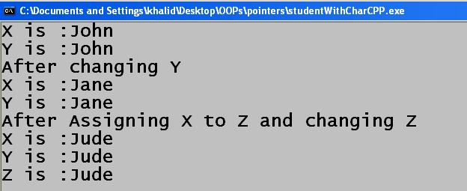
CPS235:Pointers

Slide 13
How to solve these problems?
Problems
The default copy constructor and the assignment operator copy only the class members but do not attempt to copy the data pointed to by the class members
If the copy constructor simply copied the pointer in the source object to the target object's pointer, then both objects would point to the same dynamically allocated memory. The first destructor to execute would then delete the dynamically allocated memory, and the other object's pointer would be undefined
Solution
Create your own copy constructor and overloaded assignment operator!
CPS235:Pointers

Slide 14
Shallow vs Deep Copy
Shallow copy – used to copy direct values
  If you make a shallow copy of a pointer, you would have two pointers that point to the same location
Deep copy – used to copy indirect values
  If you make a deep copy of a pointer, you will have two pointers that point to different locations but those locations have the same value
Modifying the original object should not affect its copy or vice versa
CPS235:Pointers

Slide 15
Copy constructor
Student::Student(const Student& s)
{
int len = strlen(s.name);
name = new char[len+1];
strcpy(name,s.name);
cout<<"\ncopy called\n";
}
CPS235:Pointers

Slide 16
Assignment Operator
Student& Student::operator=(const Student& s)
{
delete [] name; //to deallocate the existing array
name = new char[strlen(s.name)+1];
strcpy(name,s.name);
return *this;
}
CPS235:Pointers

Slide 17
SUPPORTING SLIDES
CPS235:Pointers

Slide 18
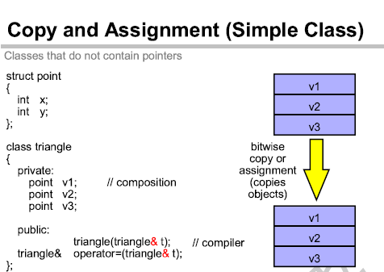
CPS235:Pointers

Slide 19
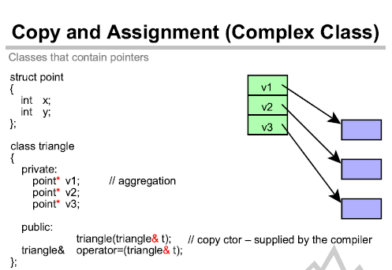
CPS235:Pointers

Slide 20
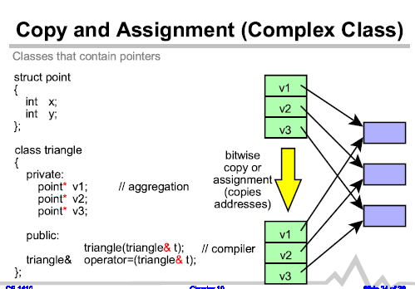
CPS235:Pointers

Slide 21
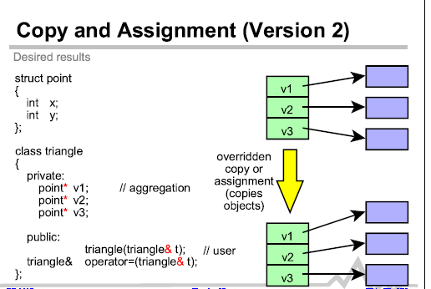
CPS235:Pointers

Slide 22
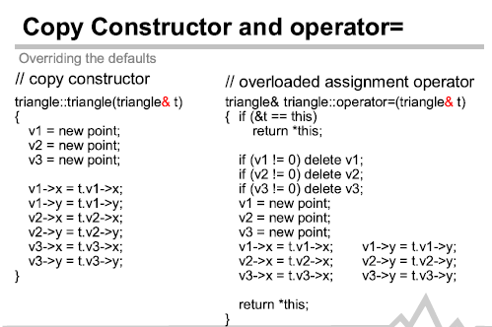
CPS235:Pointers

Slide 23
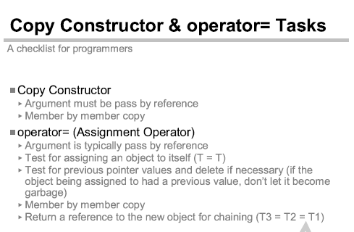
CPS235:Pointers

Slide 24
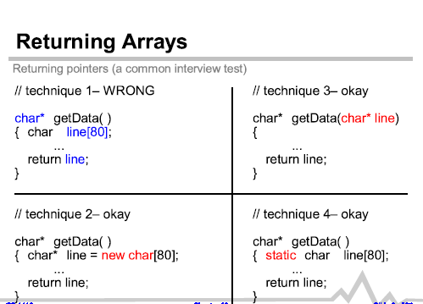
CPS235:Pointers

